Slide 1
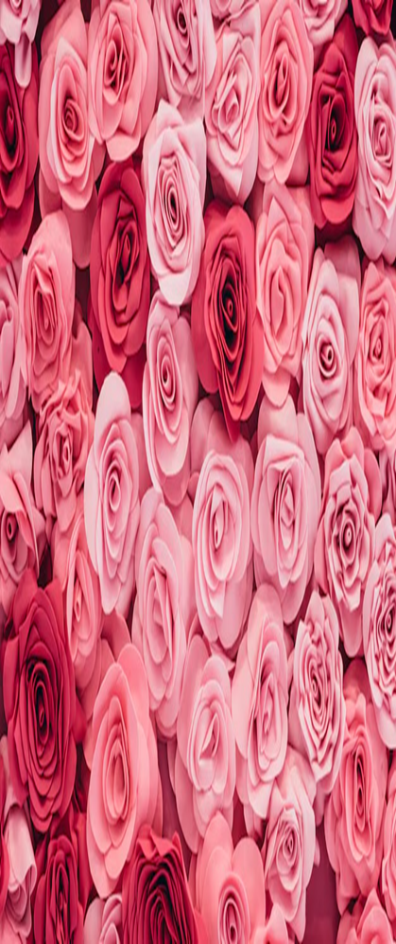
2025 Rose Parade Pasadena, California

Slide 2
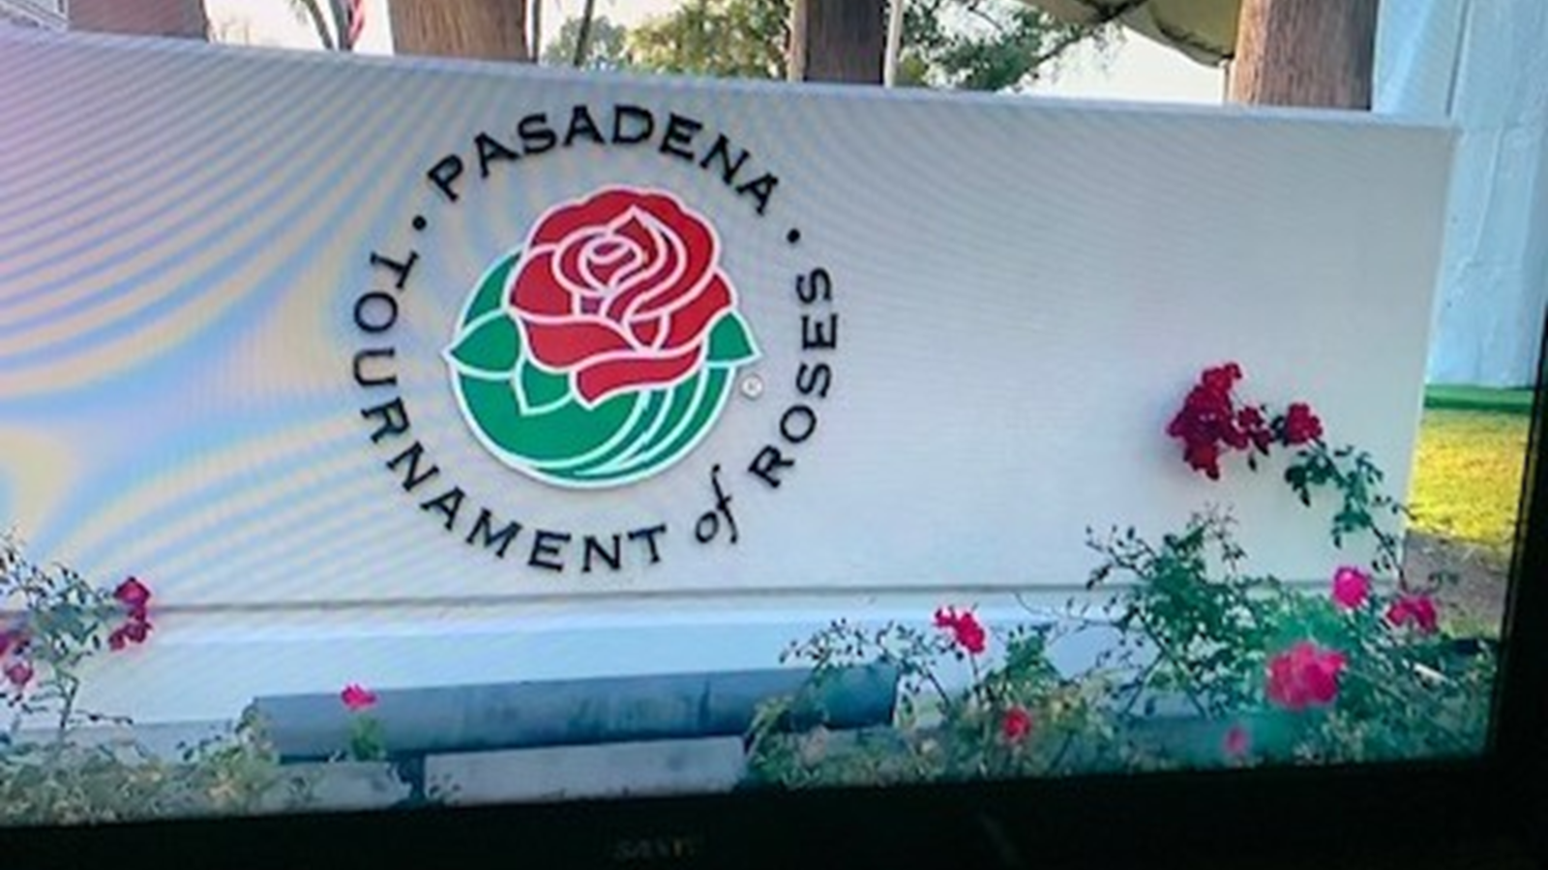
The 136th Tournament of Roses Parade is held in Pasadena, CA near downtown Los Angeles. It is held before the Rose Bowl Football game played each January 1st.
s

Slide 3
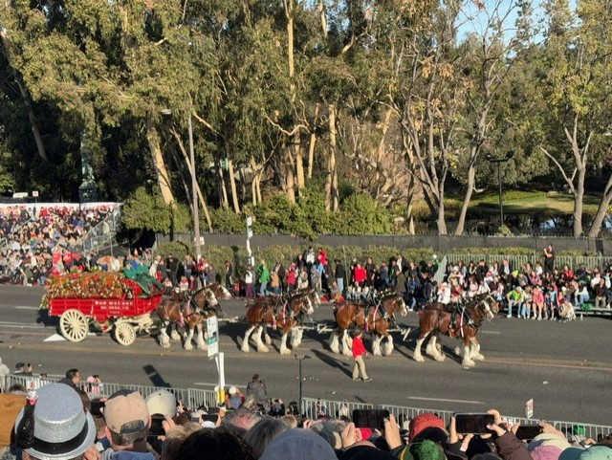
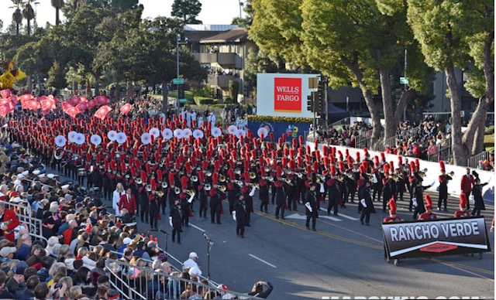
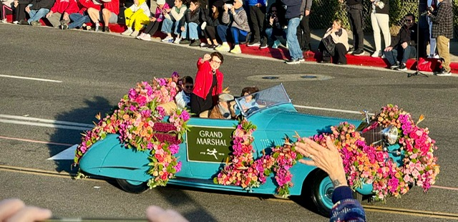
This year’s 5.5-mile parade had 39 rose-covered floats, 16 equestrian teams, 24 marching bands, and the Grand Marshal was Billie Jean King, a former world No. 1tennis player, who put an emphasis on equal pay for woman into the national spotlight.

Slide 4
This year's theme was
“Best Day Ever”

Slide 5
The process of choosing a float design is a worldwide design contest, starting the first of the year. After many meetings, a sketch is created, design is approved in March, a chassis is built.
36 days left until Parade Day, when foam is used to encase and shape the chassis, followed by painting everything in the appropriate colors.
18 Days until parade day – Test Drive and Fire Drill
6 Days, attach dry material
48 to 72 hours attach fresh flowers

Slide 6
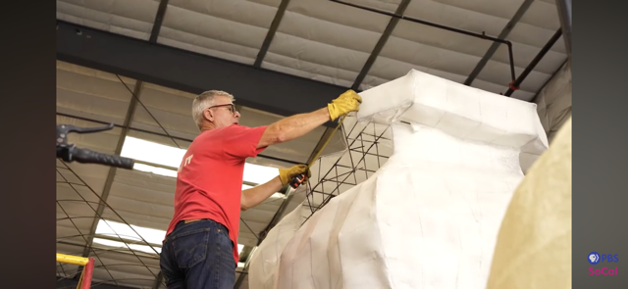
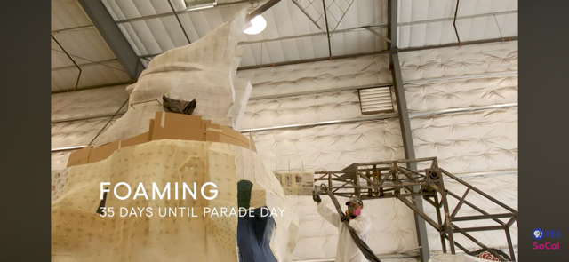

Slide 7
Dry materials are prepared either by:
Air Drying, laying a single layer out of direct sunlight, turning the petals
Microwave
Dehydrator
Oven

Slide 8
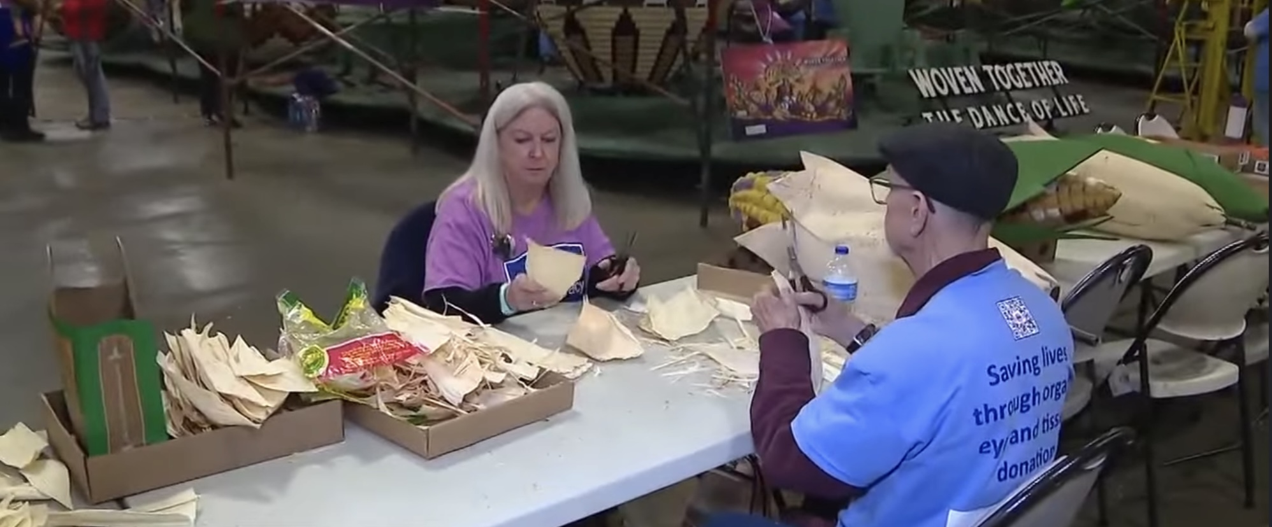
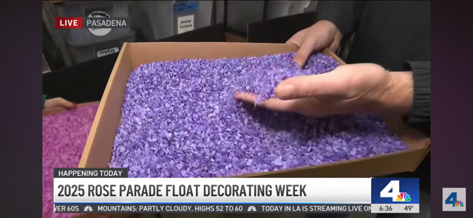
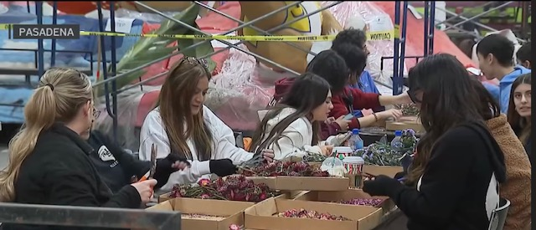
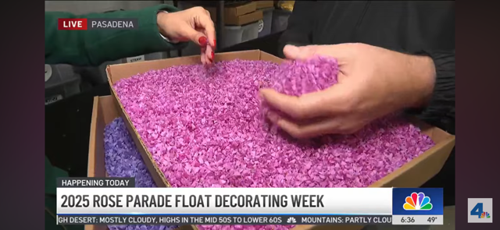
Dry materials being prepared for floats

Slide 9
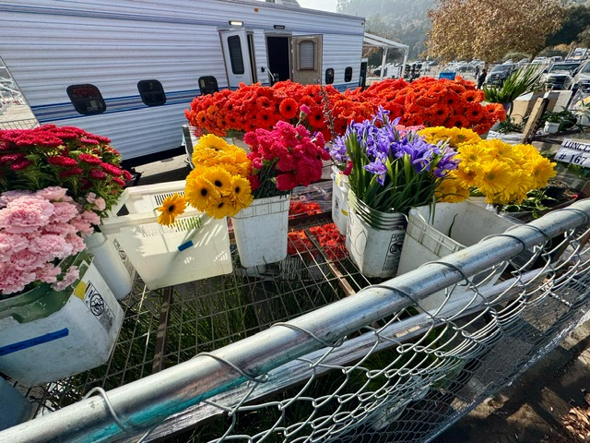
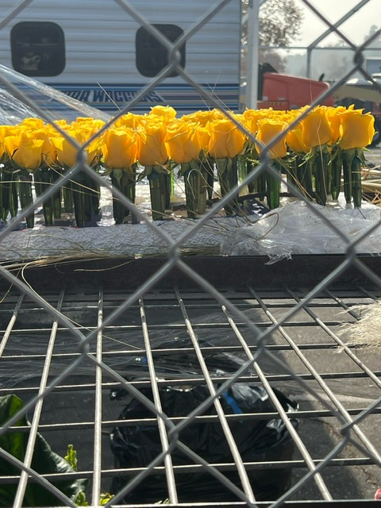
Fresh flowers, fruits and vegetables
being prepared

Slide 10
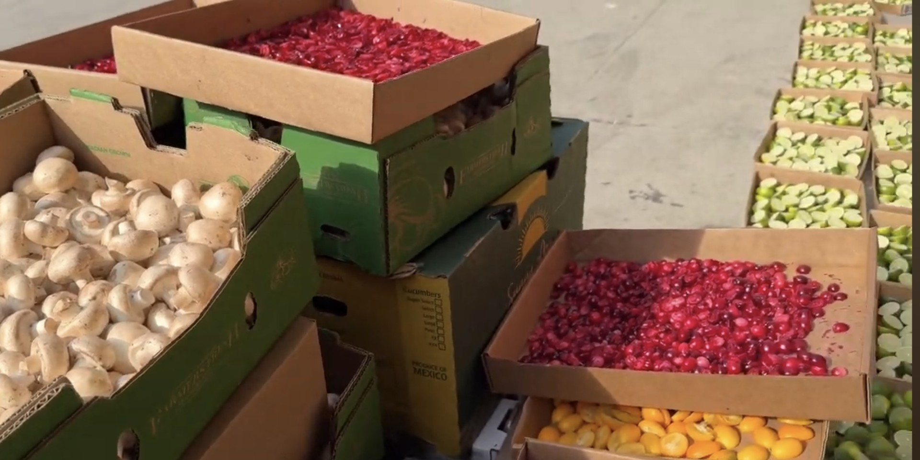
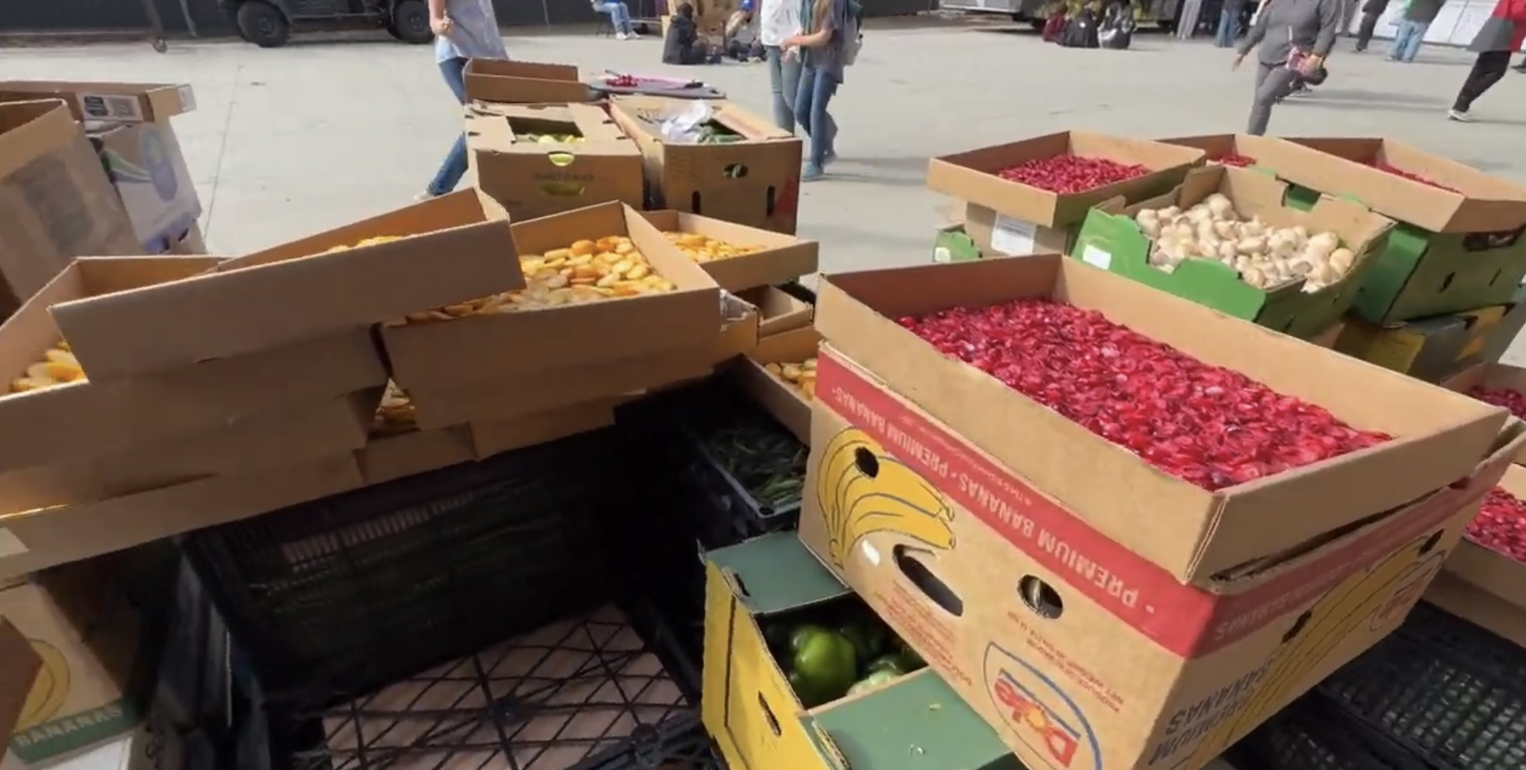

Slide 11
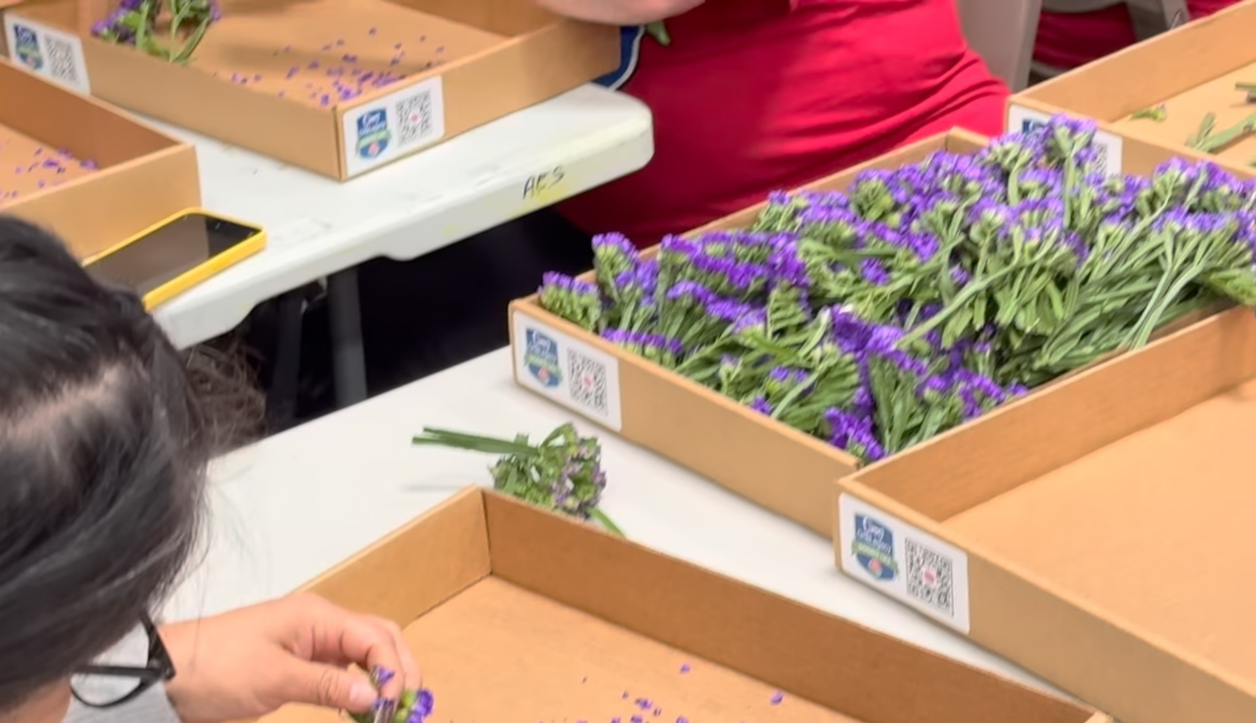
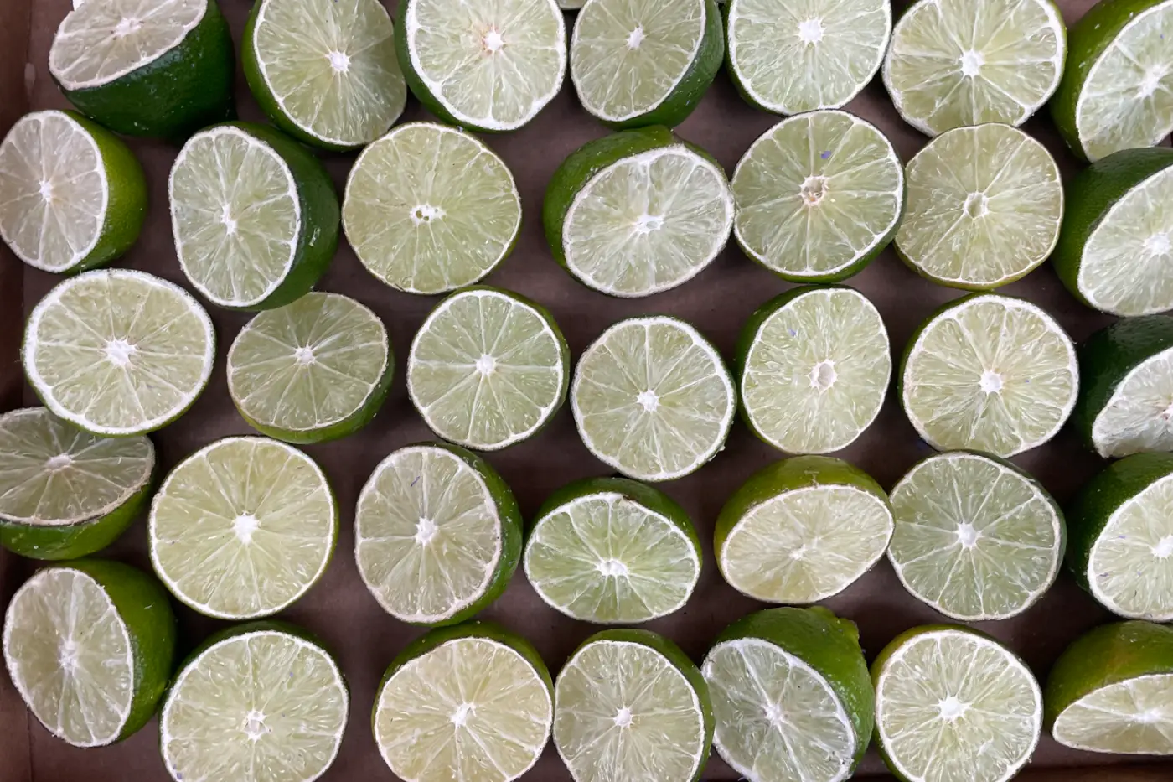
Sliced limes

Slide 12
The fresh flowers are keep fresh through refrigeration, between 33-37 degrees, to slow down their natural aging process.
They place the fresh flowers in water tubes and floral foam.
Spritzing bottles with water and flower-friendly preservatives are used to guarantee freshness.

Slide 13
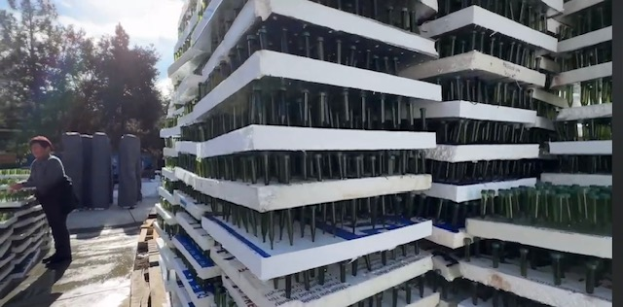
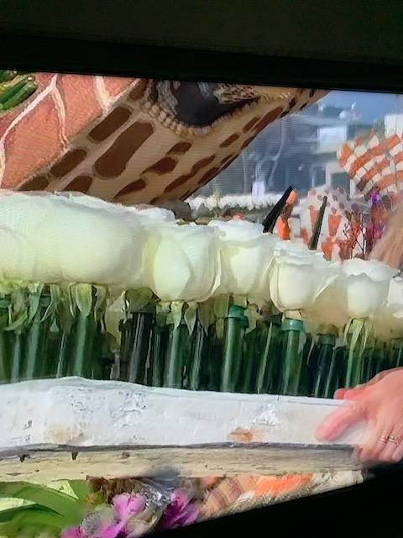
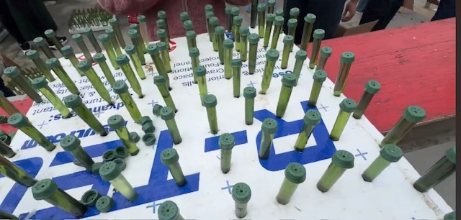

Slide 14
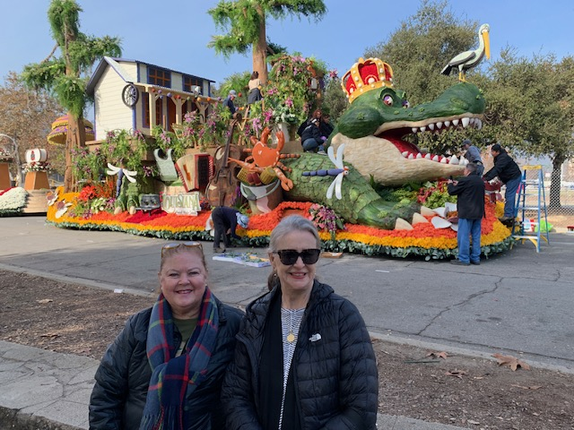
BJ and Janet in front of the Louisiana float. "Celebration Gator"
This is as close as we could get.

Slide 15
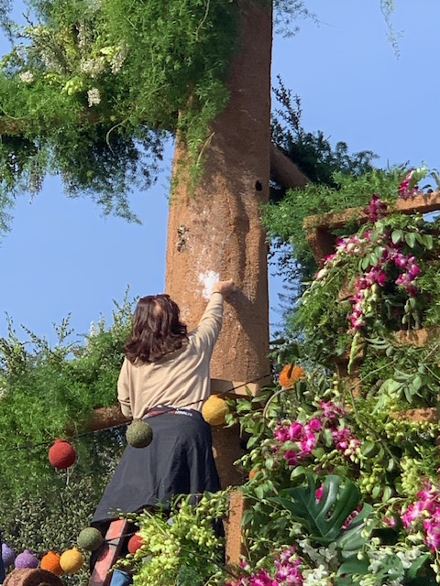
Visited Rosemont Pavilion, one of the design warehouses the day before the parade. We passed several floats from this warehouse ready to drive toward the parade lineup. Final touches were added.

Slide 16
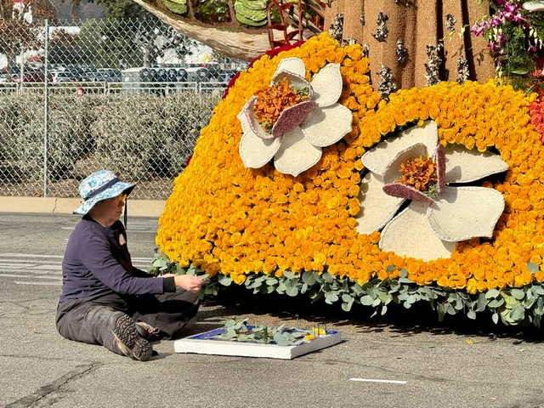
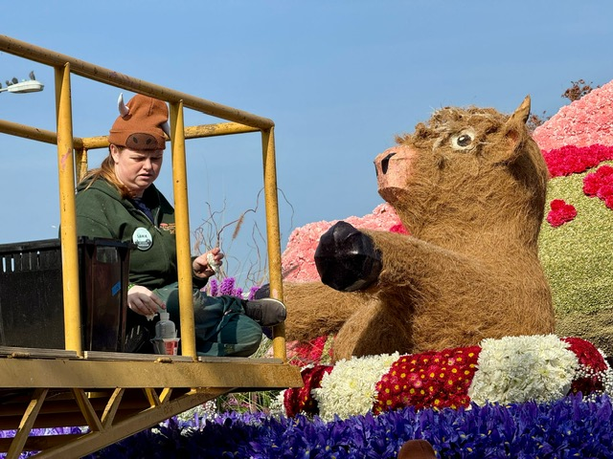

Slide 17
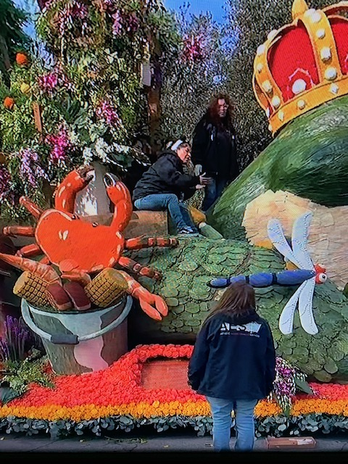
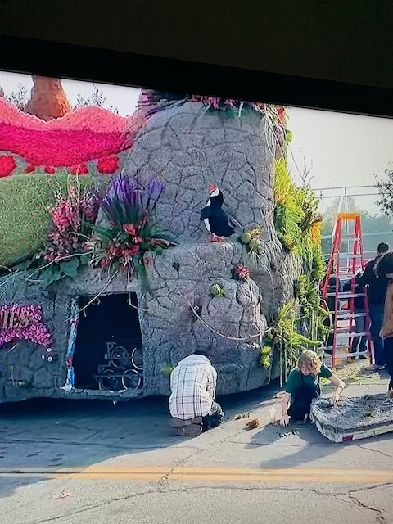

Slide 18
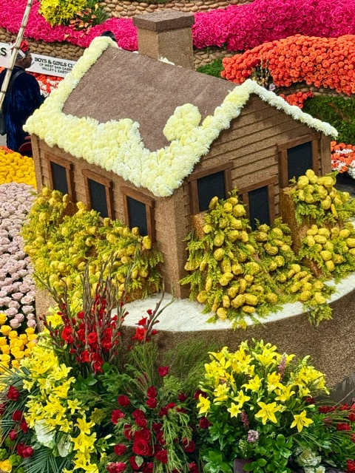
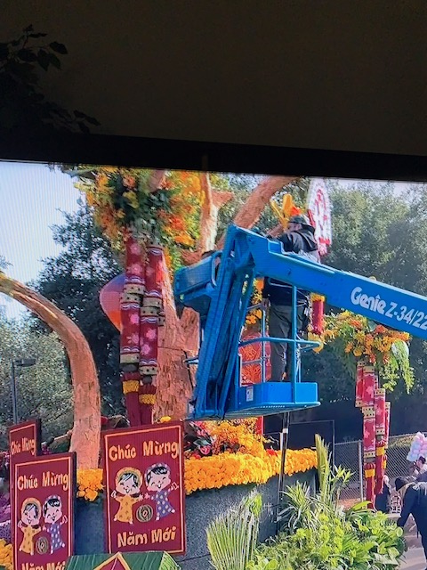

Slide 19
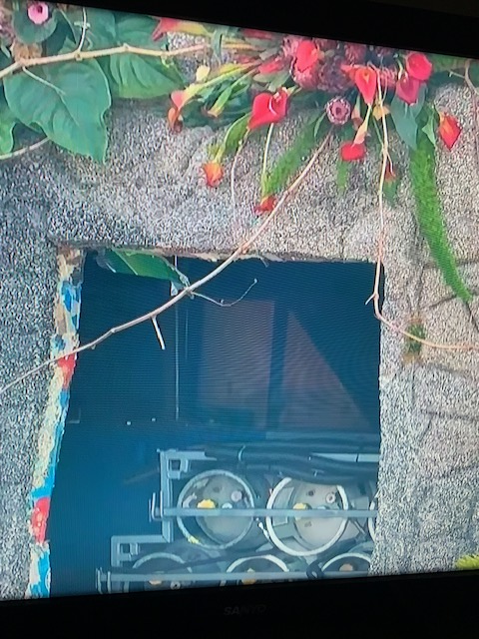
Inside the float

Slide 20
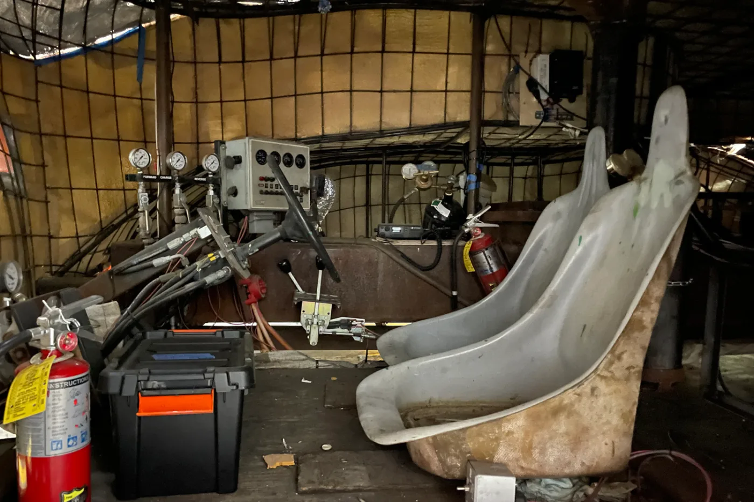
Yes, they have a bathroom on each float … It may only be a bucket.

Slide 21
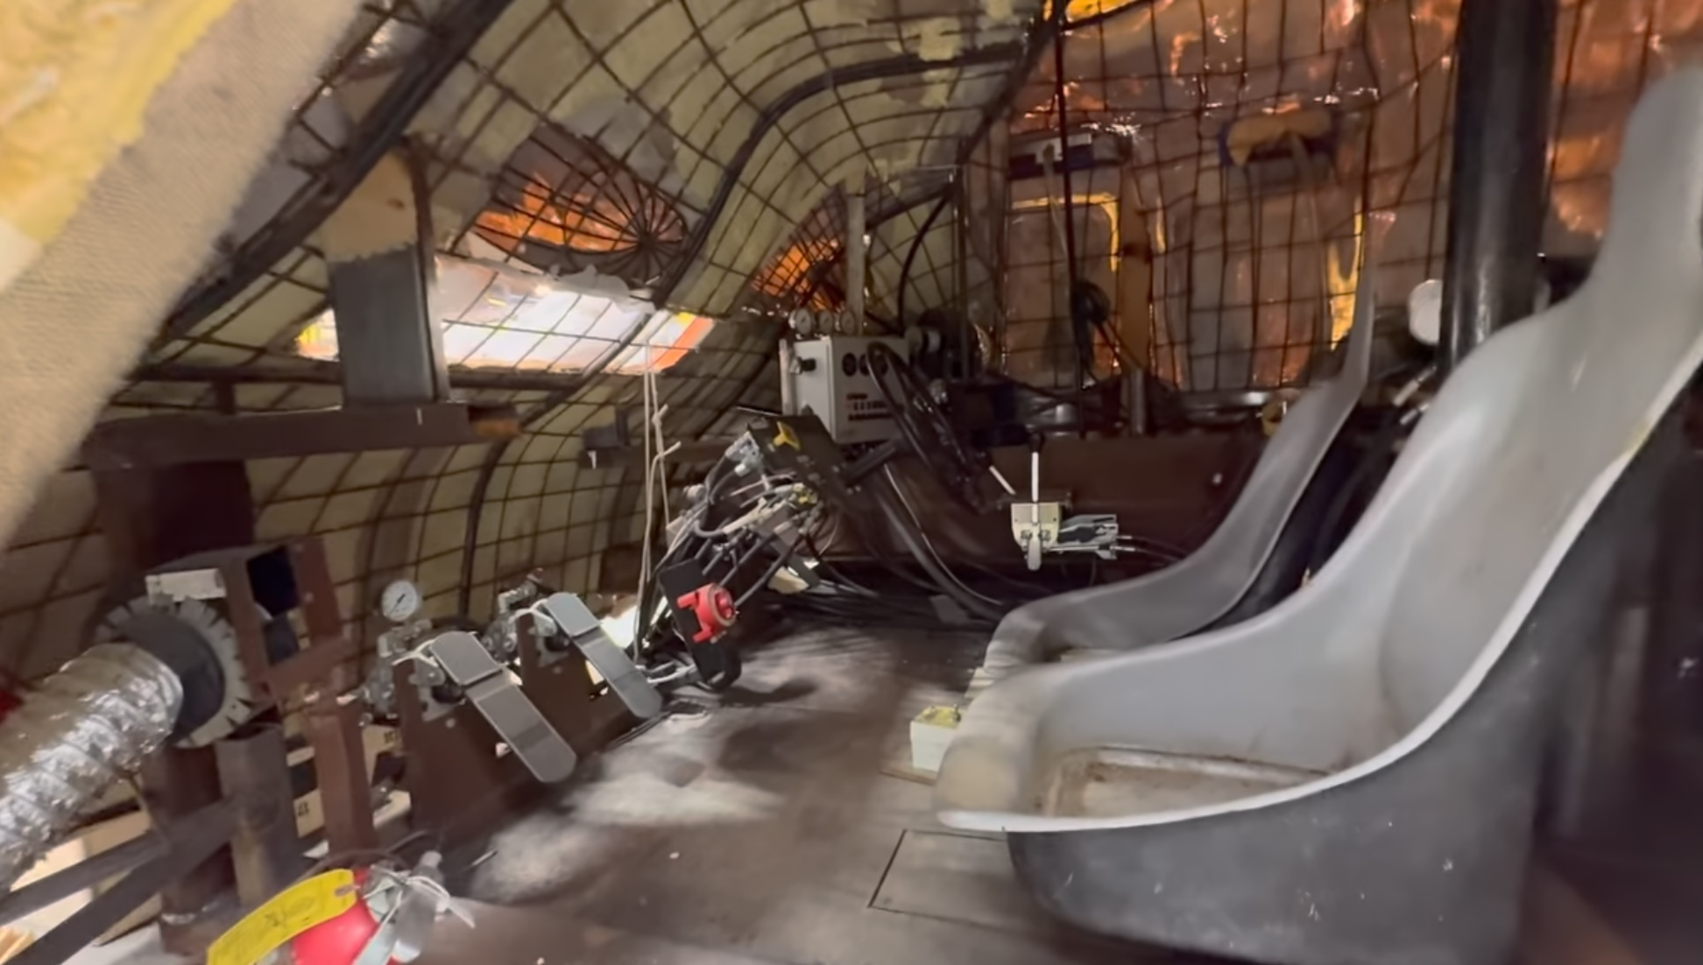

Slide 22
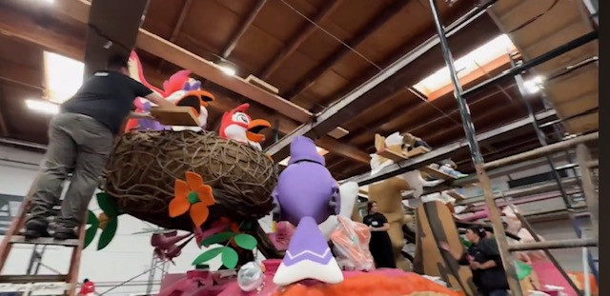
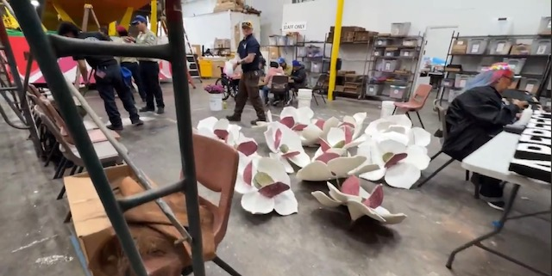
We walked inside the warehouse on a catwalk, so we could look down on the floats.

Slide 23
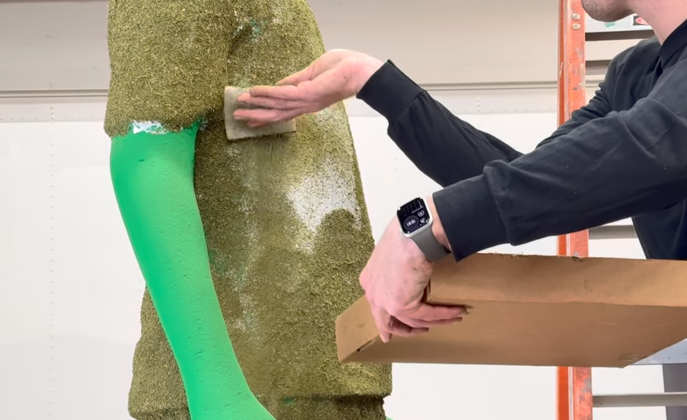
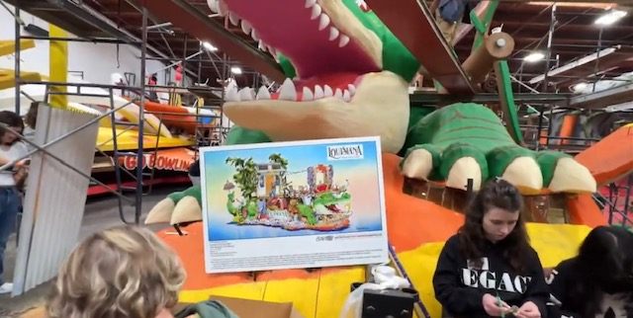
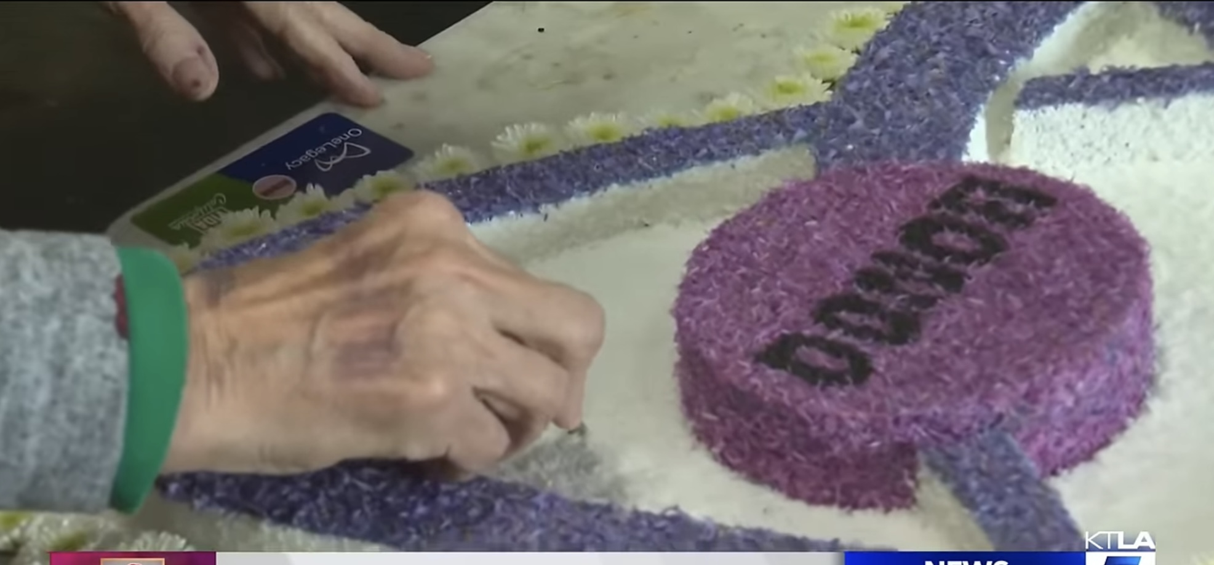
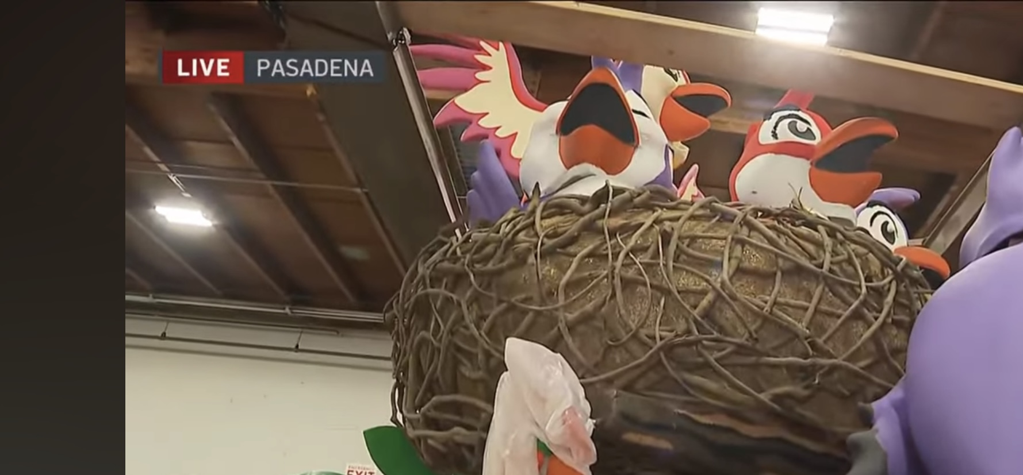

Slide 24
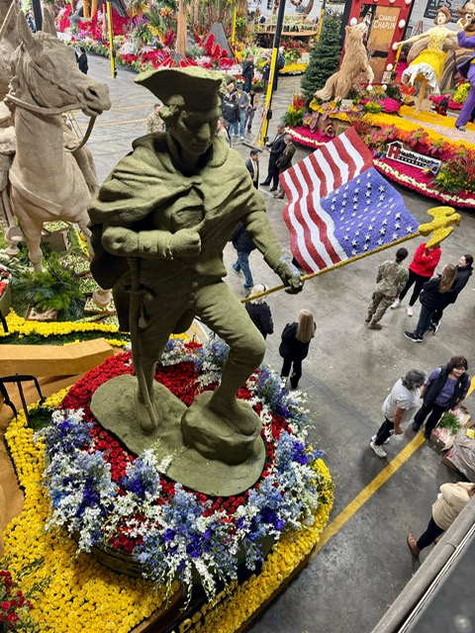
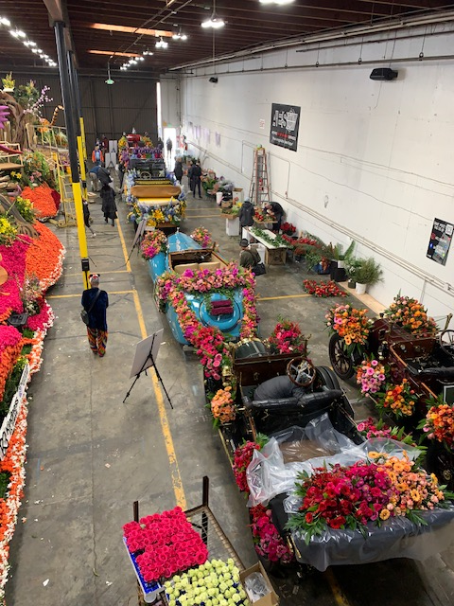

Slide 25
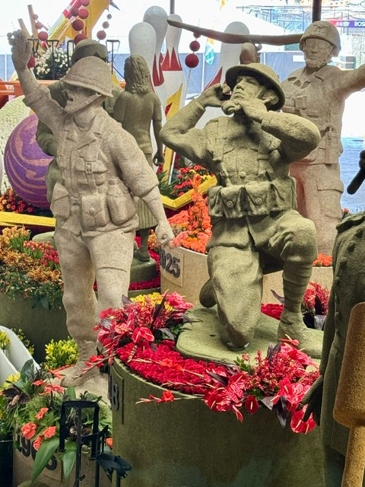
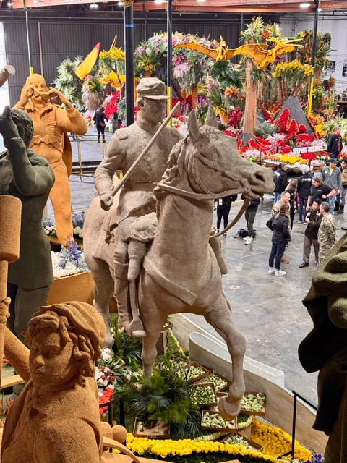

Slide 26
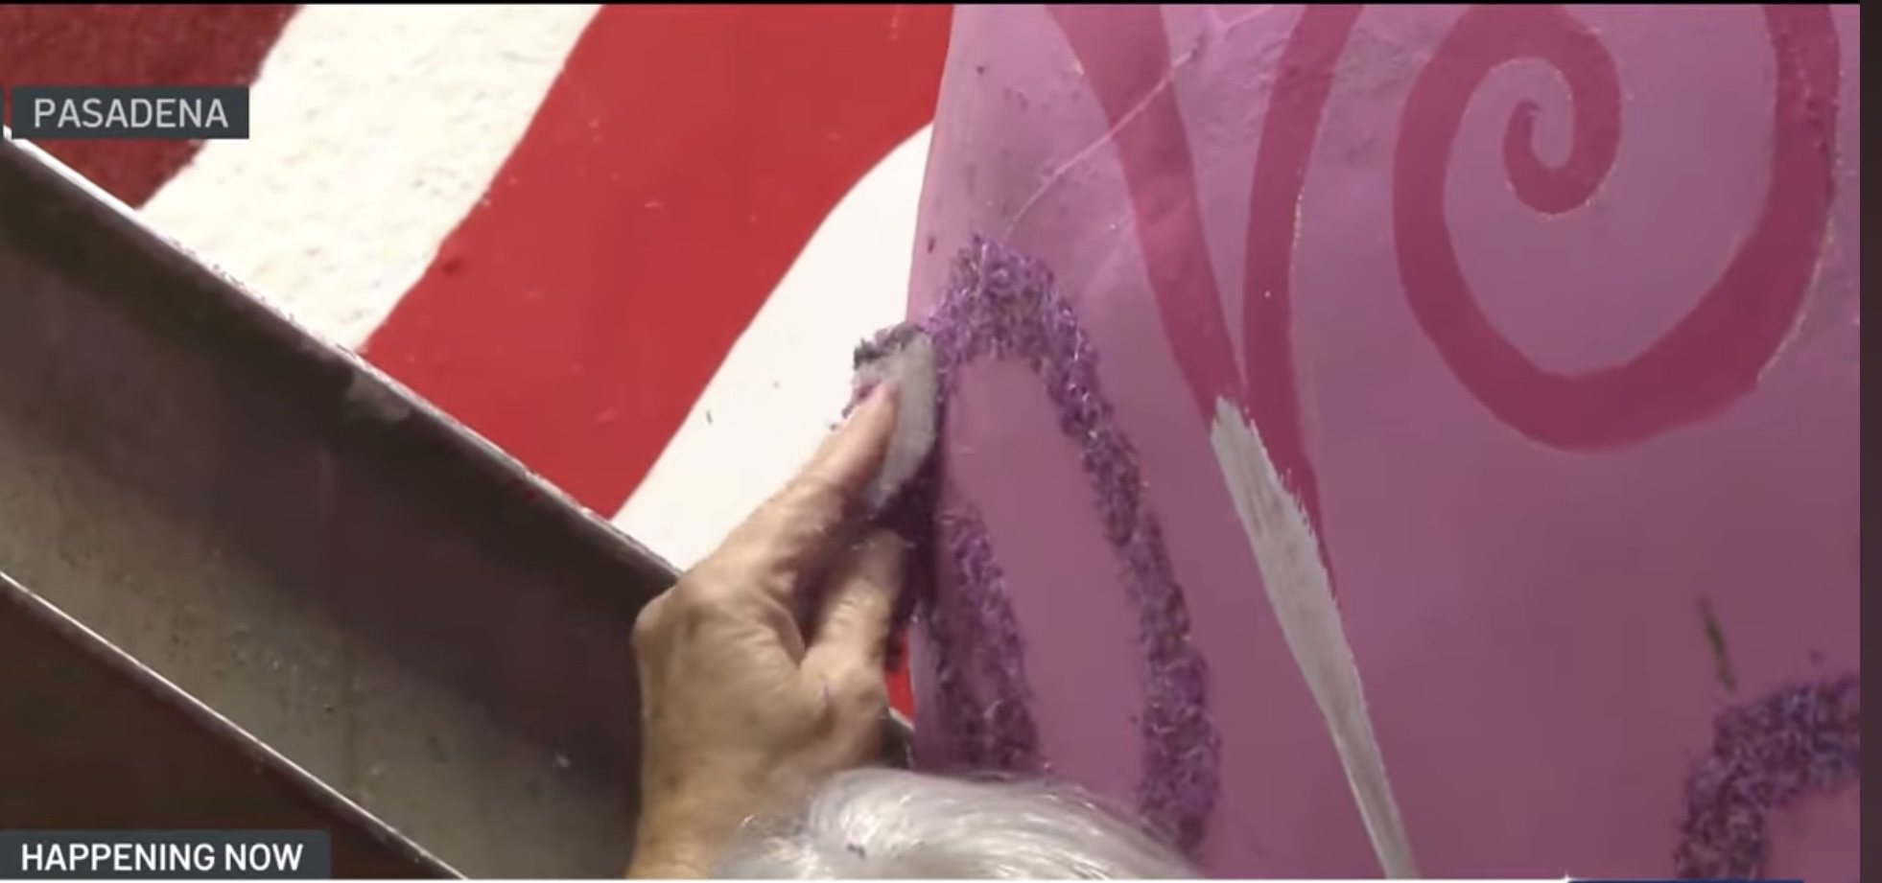

Slide 27
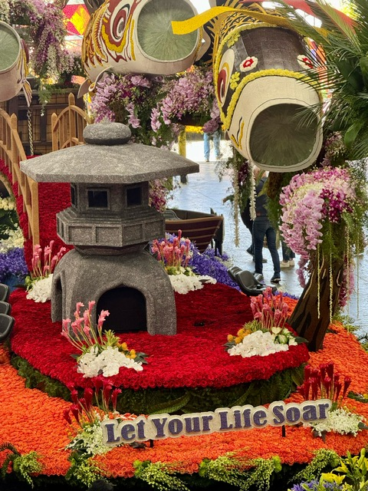
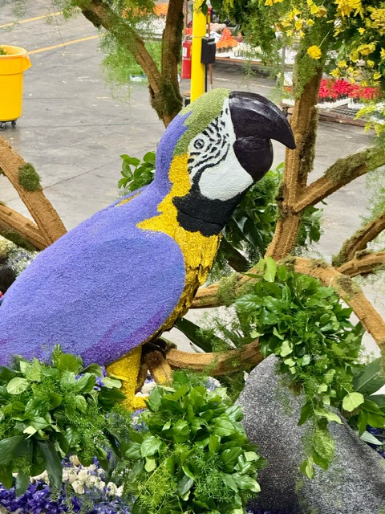

Slide 28
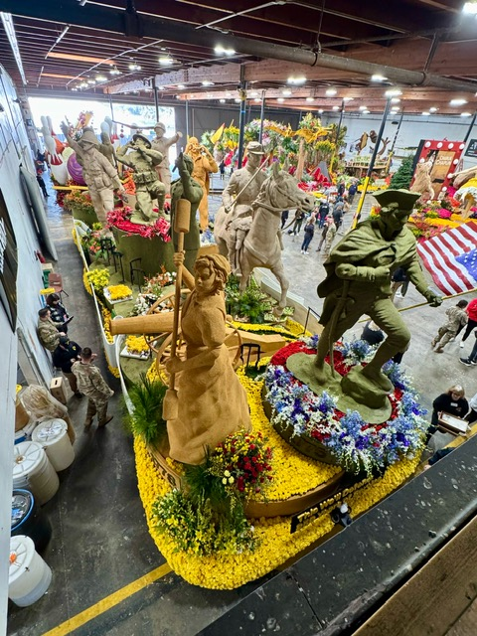
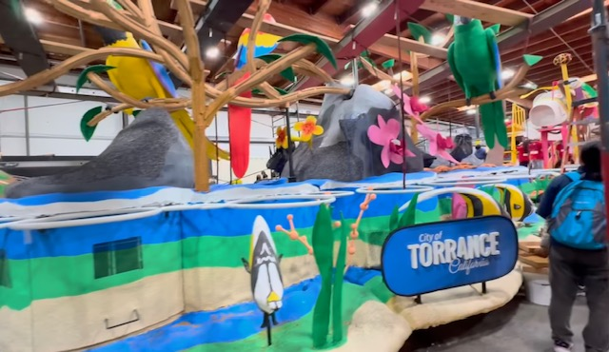

Slide 29
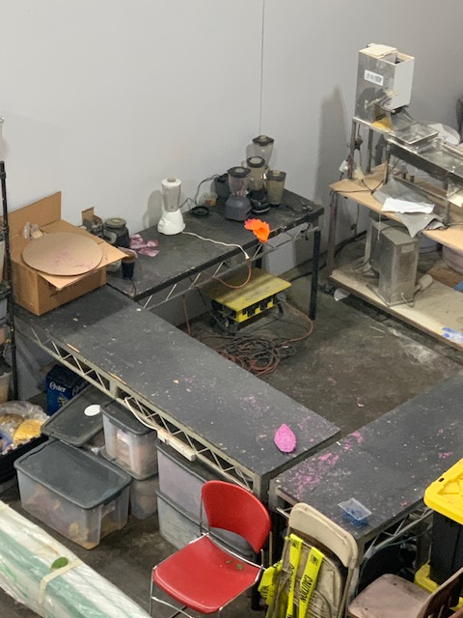
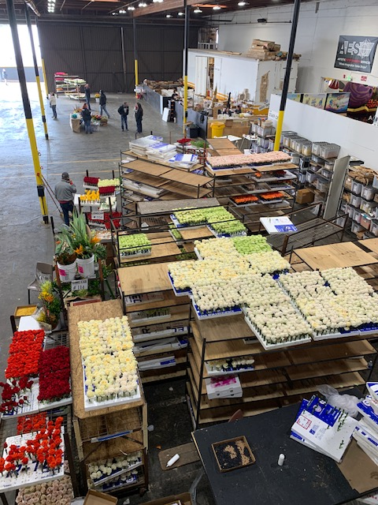

Slide 30
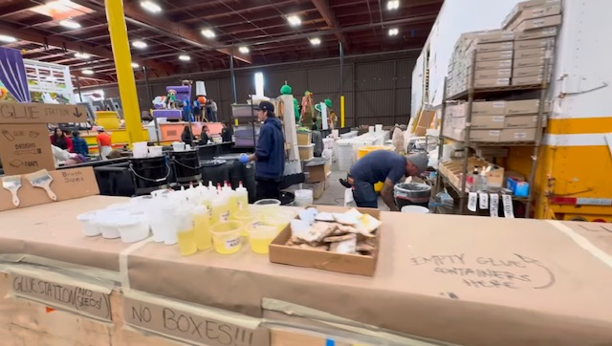
Glue Station
Types of glue used
White Glue
Rubber Cement
Contact Cement
Sticky Glue
Adhesive Spray
Hot Pay Glue
Quick-setting “oasis” Glue

Slide 31
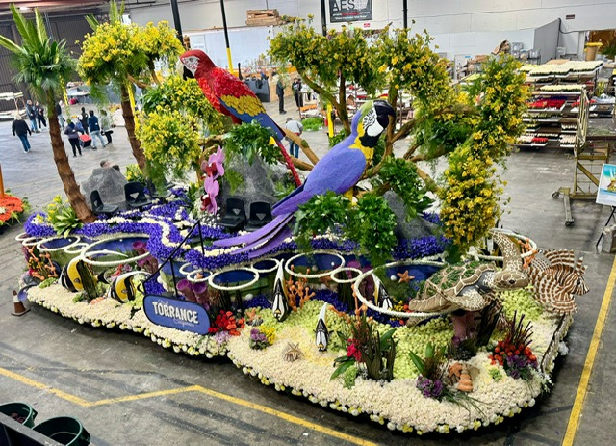
The City of Torrance’s float was designed by a high school student. “What a Beautiful Day”

Slide 32
Parrot is detailed in statice, blue delphinium and red anthurium petals.

Slide 33
The sea turtle glides above the blue irises and hydrangea petals. His back is adored with green peppers

Slide 34
The float from Louisiana, “Celebration Gator,” featured a giant alligator crafted from lime slices, broccoli florets, ti leaves, and bell peppers.

Slide 38
This gentleman was a float rider for the Louisiana float.

Slide 39
Assigned stadium seating is purchased months before the parade day, ranging $75 to $125 per seat.

Slide 40
Stadium seats are installed along the complete parade route, even in residential areas.

Slide 41
Overnight parking on Pasadena streets begins at noon the day before the parade. There is no parking along the parade route. The company that sells the stadium seating suggest places to park close to your paid seat. Seating in the downtown area can be marked off the day before by tape, and markers. Overnight camping is allowed.

Slide 42
Our view from our seat. It was a distance from the street. We had stadium pads to sit on, the metal was cold.

